Slide 1
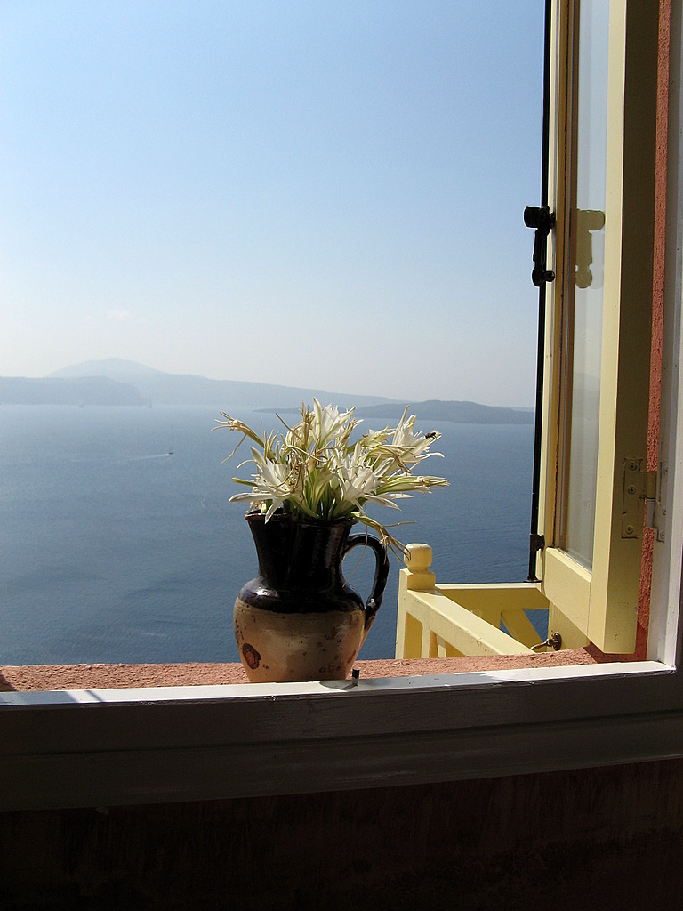


Be careful of your thoughts,
for they become your words.
The beginning is the half of every action.

Slide 2


Be careful of your words,
for they become your actions.

Slide 3


. Be careful of your actions,
for they become your habits.

Slide 4


Be careful of your habits,
for they become your character.

Slide 5

Be careful of your character,
for it becomes your destiny...

Slide 6

LIFE IS A GARDEN

Slide 7

You reap what you sow.
So, plant virtuous seeds, water them and you will surely have the most beautiful flowers. Every action, word, smile or look, is a seed.

Slide 8

Try, then, to drop your seed into the open hearts of people,
and watch their future.

Slide 9

Make sure that it is like wheat
that gives bread to people, and does not
produce thorns and weeds that leave barren souls.

Slide 10


Many times you will sow in tears,
but that sowing will allow you to reap with shouts of joy.

Slide 11

Very often you will plant while crying, but perhaps
your plant needs your tears in order to germinate.

Slide 12
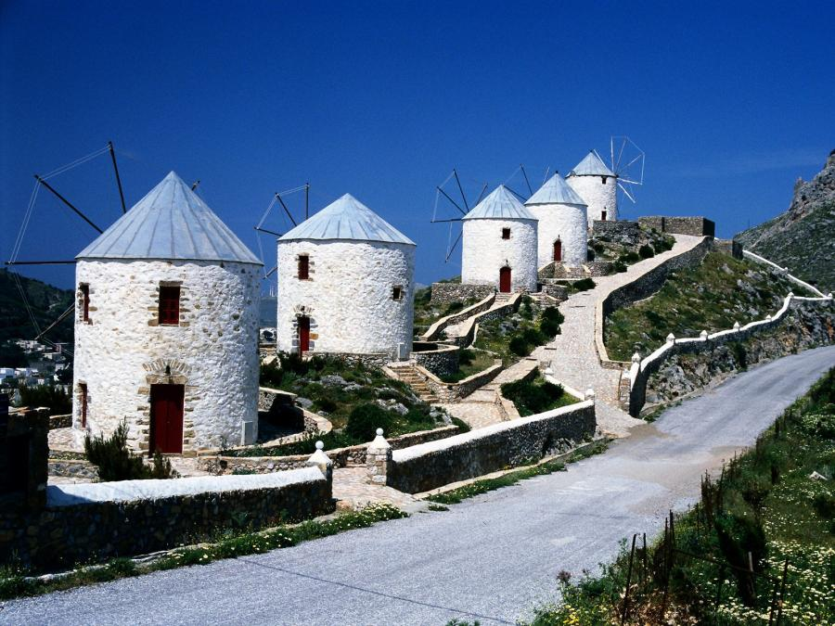

Don't take the storms in your life as punishments. Believe that the strong winds will deepen your roots so that your rosebush while be able
to withstand what is yet to come.

Slide 13

And, when your leaves fall, do not lament; they will serve as your own compost.
You will grow green again and have new flowers.

Slide 14

Every act, every word, every smile, is a seed.
Always try to plant "a seed of love".

Slide 15

We are the product of what we feel and think. Thus, much of what happens in our daily lives is influenced by our own inner strength.

Slide 16

The antidote to bad luck is in each and every one of us.
It is in our demeanor and in our way of life.
It is in the way we channel the energy within us.

Slide 17

Above all, it is in the way we transmit that energy
to those who are close to us.

Slide 18

If we permanently affirm positive things with absolute faith,
we will achieve anything
with a good purpose,
which we want God to grant to us, whether it be for our own health, work, family or friends.

Slide 19


The power of the faith that we put into all
that we ask for will be crucial when it comes time
to receive His graces and blessings.

Slide 20

Have a good day!
15/10/2015 16:18:02

Slide 21



Slide 22


Slide 23
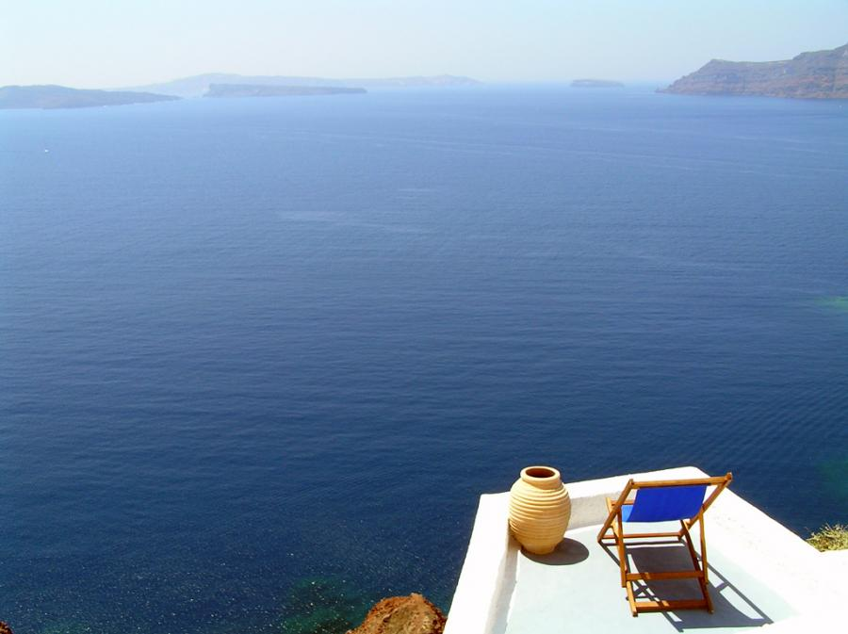

Live today, forget the past.
Images: Internet
Music: Zorba’s dance (Sirtaki)
Adriana

