Slide 1
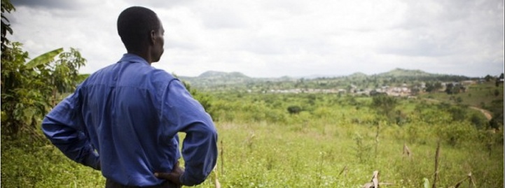
LAND GRABBING
The Rush for Land

Slide 2
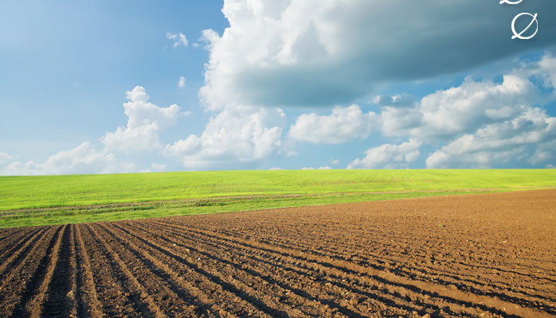
International Investments in Land
International investment in agriculture plays a vital role in development and poverty reduction. Investment can improve livelihoods and bring jobs, services, and infrastructure, but only if it is managed responsibly within the context of an effective regulatory framework.
The recent record of investment in land shows it to be very different. It tells a story of rapidly increasing pressure on land – a natural resource upon which the food security of millions of people living in poverty depends.
Without national and international measures to defend the rights of people living in poverty, this modern-day land-rush is likely to leave too many poor families worse off, often evicted from their land with little or no recourse to justice.

Slide 3
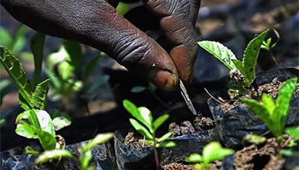
Land Grabbing
International agencies and organizations are studying the land acquisition problem: it appears that in many cases it’s more accurate to speak of “land grab” rather than “land deal.” Land grabbing is an ambiguous activity because:
♦ It encompasses large-scale acquisitions of farmlands by foreign governments, international companies or investment funds – in poor countries – in order to produce food, fodder and bio-fuel;
♦ It is realized through acquisition or long-term lease contracts, for 50 or even 90 years. In this way, legal instruments are seen as supporting land purchases;
♦ Land “deals” are predominant in poor or developing countries, where the land system is based on informal and traditional laws, recognized locally but not by international agreements. There are no guarantees on land rights for local communities and, for this reason, peasants cannot prove they are land owners or users;
♦ These contracts are made in exchange for infrastructure realization, market access, wealth assistance, but there are no guarantees to ensure the realization of these things.

Slide 4
So, land acquisitions are made through investment contracts that are:
♦ formally correct;
♦ not in violation of any international or national rule; since any specific set of rules on land grabbing doesn’t exist yet.
To understand if a specific land acquisition is a form of land grabbing or not, it’s necessary to analyze if there is:
any violation of human rights, particularly the equal rights of women;
any neglect of free, prior, and informed consent of affected land users;
a thorough assessment of the acquisition, or is there disregard for social, economic and environmental impacts, including gender injustice;
transparency within the contract that specifies clear and binding commitments about activities, employment, and benefits-sharing;
effective democratic planning, independent oversight and meaningful participation.

Slide 5
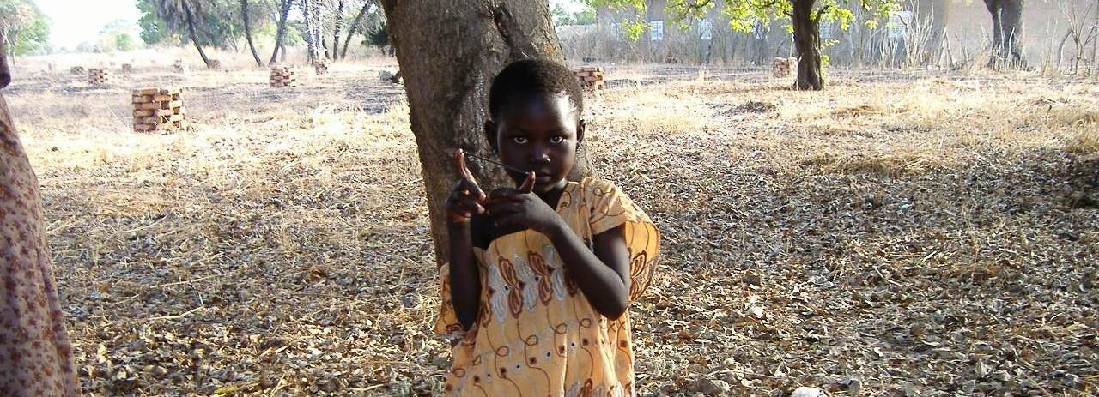
National governments have a duty to protect the rights and interests of local communities and land rights-holders.
♦ Governments often fail, because they are corrupt and align themselves with investors, enticing them with low land prices and other incentives, and even helping them clear people from the land for personal gain.
♦ Even when foreign capitals or banks, that follow responsible policies, are involved in land acquisition, investments are rarely made with responsible standards.
♦ Local communities have tools, internationally recognized, to provide protection remedies but often they are not implemented.
♦ It’s necessary that the international community illuminate this problem, find solutions that favor sustainable investments in land, since so many national governments don’t protect the rights and interests of local communities.

Slide 6
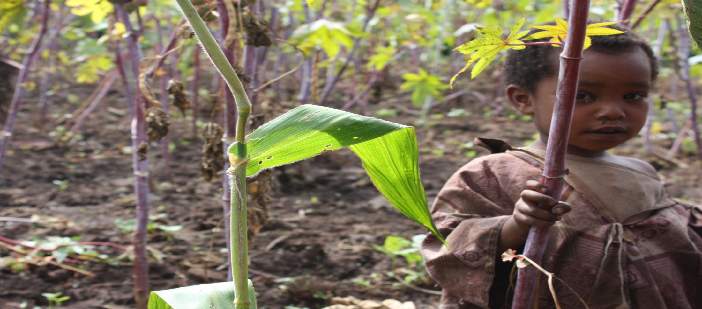
A call from the Bishops of Africa
To oppose this “assault,” the Bishops of Africa (Synod for Africa , October 2009) “urged that the Church in Africa:”
“seek information (...) and educate the People of God and enable them to challenge unjust decisions in these matters” (propositio 30);
“press governments to adopt a suitable juridicial framework that takes into account the interests of our countries and their populations” (propositio 29); and
guarantee that “their citizens are protected against unjust alienation of their land and access to water which are essential goods for the human person” (propositio 30).
They also asked governments to “respect the traditional land rights and to recognize them by law” (propositio 30).

Slide 7
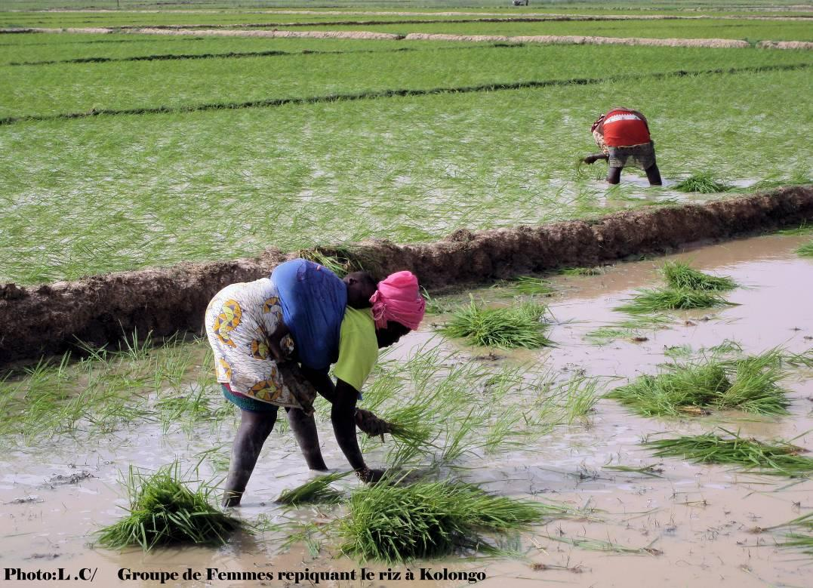
“Land occupation is often an expression of an intolerable and morally indefensible state of affairs, and is an alarm bell calling for the implementation of effective and equitable solutions on the social and political level”.
(Pontifical Commission for Justice & Peace, November 1997, §44)
The Church clearly states that:
Land is a “common good” given by the Creator for the needs of all, now and in the future.
The right to use of land is natural and primordial; it is a universal value that applies to every human being and should not be overridden by any other economic right.
Its social doctrine supports private property as a means of achieving autonomy and freedom; a means, however, that is subordinate to the first social function of property: to enable each and every person to live.
It condemns the latifundia because they "deprive a vast number of people of the right to take part in the process of production through their own labor and to take care of their own needs... "(Pontifical Commission for Justice & Peace, November 1997, n. 32)

Slide 8
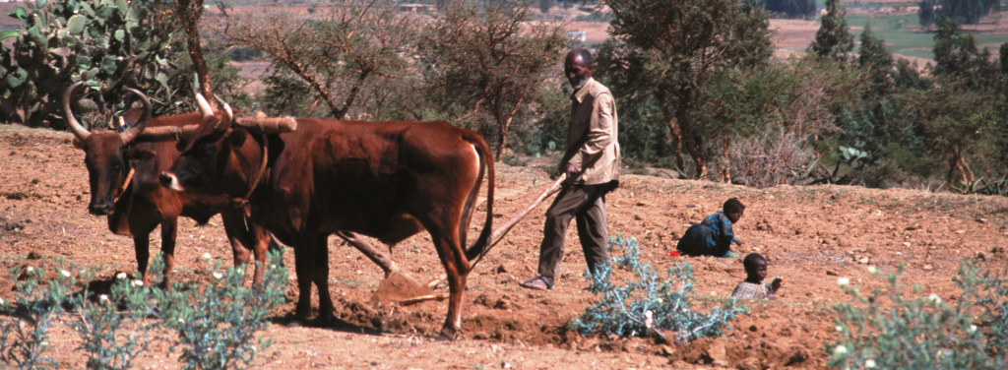
“Woe to those who join house to house, who add field to field.” (Is 5:8)
“They covet fields and seize them.” (Mic 2:2)
What does the Bible say?
The prophets of the Old Testament as well as Jesus in the New Testament left no doubt about the scandal of land accumulation in the hands of a few.
The accumulation of resources, while others lack the necessities of life, is in contradiction
with the purpose of creation: God created all in abundance such that every human being can enjoy His gifts.
The disrespect of the powerful for the dignity and the rights of persons is constantly
condemned by the prophets.
Jesus condemns the accumulation of riches in the face of poverty and deprivation with
unusual sharpness: “Woe to the rich…”(Lk 6:24). He dramatizes the fate of such abuses of creation in the parable of Lazarus and the rich man: they will have no part in God’s promise.

Slide 9
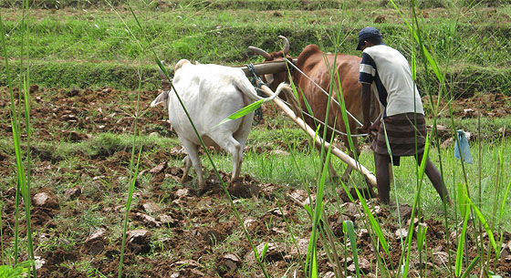
Community and Pastoral Reflection
• Does Land Grabbing exist in our country or area?
• Are our national and traditional laws known and respected?
• Do our peasants know the legal mechanism to protect their land rights?
• Does the Christian community:
- Recognize the importance of this problem?
- Collect documents and information to help protect the land for poor people?
- Collect data about any abuses and injustices?
Notes:
Reviewed by Cindy Browne, 12/10/12. Suggested changes in RED.

